Slide 1
SCADA Protocols

Slide 2
Evolution of SCADA Protocols
SCADA protocols evolved out of the need to send and receive data and control information locally and over distances in deterministic time.
Deterministic in this context refers to the ability to predict the amount of time required for a transaction to take place when all relevant factors are known and understood.
To accomplish communication in deterministic time for applications in refineries, electric utilities, and other users of SCADA systems, manufacturers of control devices, such as PLCs, developed their own protocols and communication bus structures

Slide 3
Manufacturer and their Protocols
MANUFACTURER PROTOCOL
1. Allen Bradley (Rockwell): DeviceNet, ControNet, DF1, Data Highway +, Data Highway 485
2. Siemens: Profibus
3. Modicon: MODBUS, MODBUS Plus, MODBUS TCP/IP

Slide 4
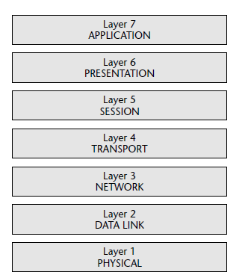
OSI Model

Slide 5
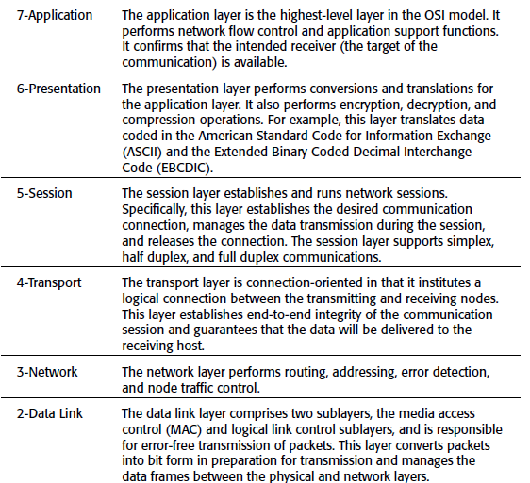
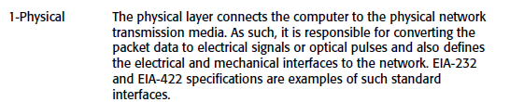
OSI Model

Slide 6
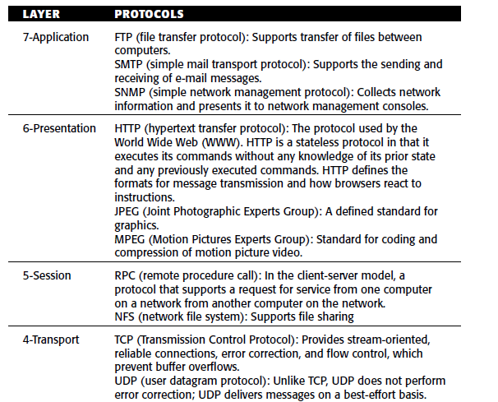
OSI Model

Slide 7
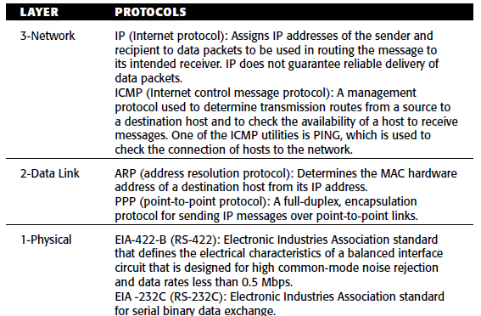
OSI Model

Slide 8
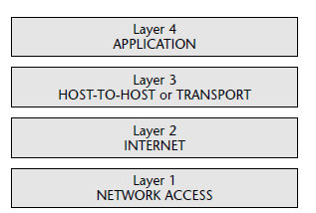
TCP/IP
The transmission control protocol/Internet protocol (TCP/IP) was developed in the 1970s by the U.S. Department of Defense to implement reliable network communications.
TCP/IP powers the Internet and the Internet’s various capabilities are based on TCP/IP protocols

Slide 9
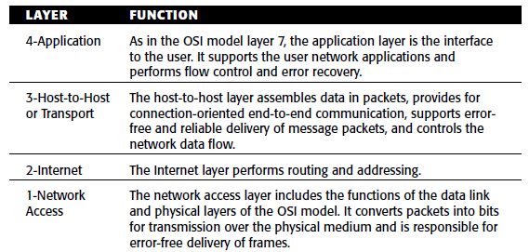
TCP/IP

Slide 10
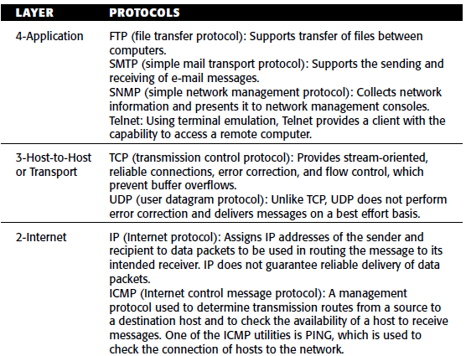
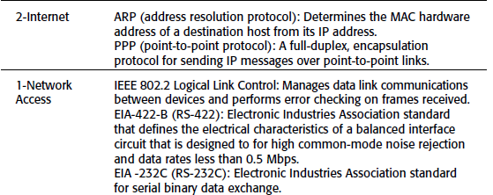
TCP/IP

Slide 11
MODBUS Model
In an effort to take advantage of new networking developments, SCADA protocols incorporated versions of Internet and local area network technologies.
This move led to some standardization, but also exposed SCADA systems to attacks commonly used against these technologies in IT environments.
In the late 1970s, Modicon, Incorporated, developed the MODBUS protocol.
MODBUS is positioned in layer 7 (the application layer of the OSI model) and supports client-server communications among Modicon PLCs and other networked devices.

Slide 12
MODBUS Model
The MODBUS protocol defines the methods for a PLC to obtain access to another PLC, for a PLC to respond to other devices, and means for detecting and reporting errors.
The protocol supports other protocols such as asynchronous master-slave transmission, Modicon MODBUS Plus, and Ethernet.
In order to take advantage of the supporting tools, hardware, and software that are used for the Internet, MODBUS/TCP was also developed.
This too is based on the OSI model, although not all layers are used.

Slide 13
MODBUS Model
A typical MODBUS transaction comprises the following steps:
1. The MODBUS Application protocol sets the format of a client-initiated request.
2. A function code in a MODBUS data unit, as the message packet is called, directs the server to execute a specific action.
3. A data field in the message provides additional information used by the server to perform the requested action.
4. If there are no errors in the exchange, the server completes the requested action, typically sending data back to the client.
5. If an error occurs, the server reads an exception code in the data unit to determine the next action to be performed

Slide 14
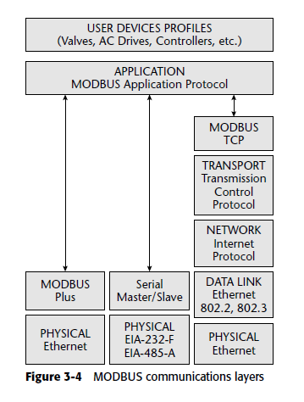
MODBUS Communication layers

Slide 15
DNP3 Protocol Introduction
DNP3 is an open SCADA protocol that is used for serial or IP communication between control devices.
It is widely used by utilities such as water companies and electricity suppliers for the exchange of data and control instructions between master control stations and remote computers or controllers called outstations. Typical commands issued by the master control station are
“open a valve,”
“start a motor,” and
“provide data on a particular control station.”

Slide 16
Introduction
The master control station might also provide analog output signals to the outstation.
An outstation provides the master control station with information such as pressures, status of a circuit breaker or recloser, analog signals representing such items as temperature or power, and information files.
DNP3 has also adapted to Internet technologies by using TCP/IP for exchange of DNP3 messages.

Slide 17
Introduction
●
DNP3 used for communications between SCADA masters (control centres) and remote terminal units (RTUs) and/or intelligent electronic devices (IEDs)
DNP: Distributed Network Protocol
SCADA: Supervisory Control And Data Acquisition
Protocol defined in “Basic 4” document set from DNP Users Group
Based on IEC 60870-5.
International counterpart: IEC 60870-5-101
●
●
●
●
●

Slide 18
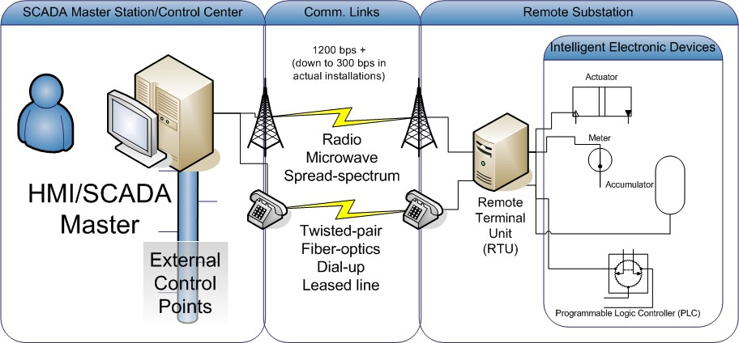
Protocol Overview

Slide 19
Protocol Participants
SCADA Master Stations/Control centres
Connected to HMI and other control centres
Remote terminal units
Interface between IEDs and master stations
May exhibit limited autonomous control
Intelligent electronic devices
Sensors and meters
Relays and other actuators
Programmable Logic Controllers: PLCs
●
●
●

Slide 20
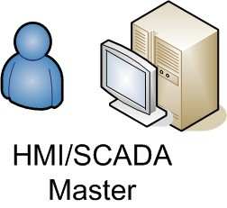
SCADA Master Basics
●
Control centre from which multiple substations or other remote installations are controlled and monitored
Connected to other control centres using ICCP, a separate protocol
Interfaces with human through HMI (Human- Machine Interface), which may be local or remote.
Connected to RTUs and/or IEDs
●
●
●

Slide 21
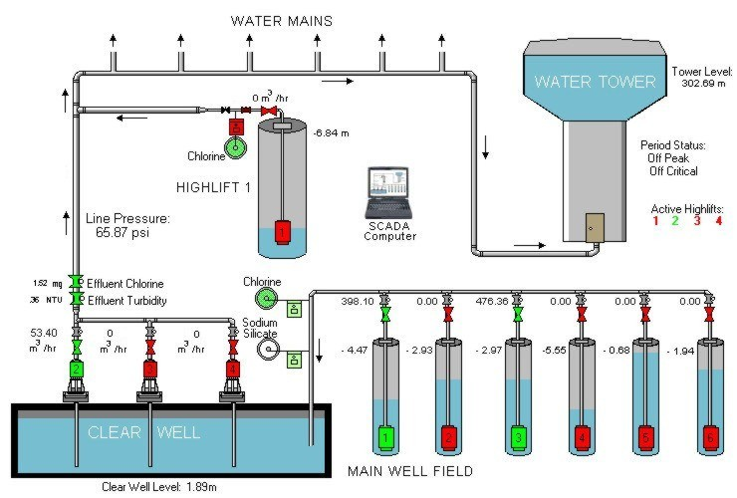
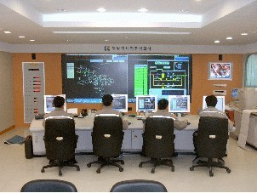
Sample SCADA Masters
Water SCADA HMI
Korean control center

Slide 22

RTU Basics
●
Remote Terminal Unit
Appears as IED to SCADA master when DNP used for communications
Manages multiple actual IEDs
Attached IEDs referenced using absolute addressing scheme
Addresses only have meaning to SCADA master
●
●
●
●

Slide 23
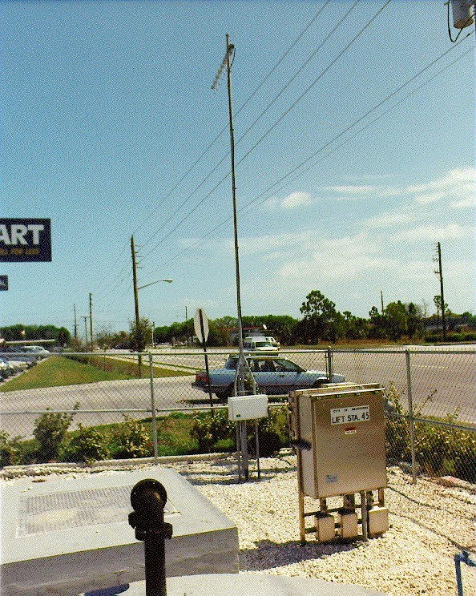
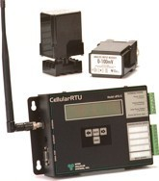
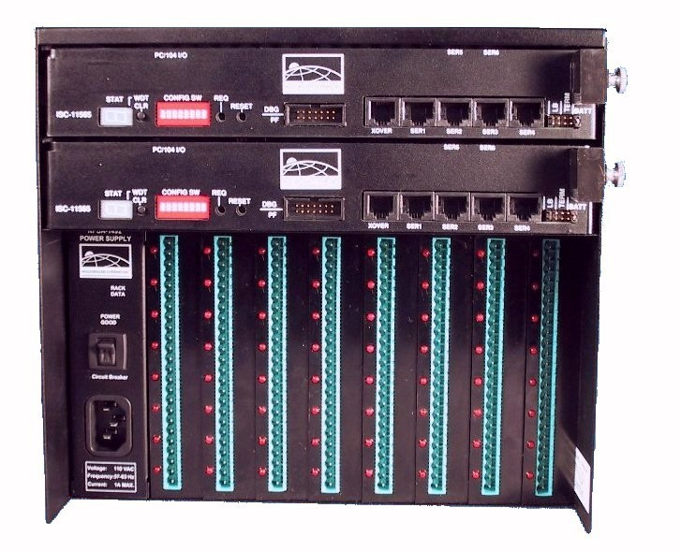
Sample RTUs
Radio RTU
Cellular
RTU
Serial RTU

Slide 24
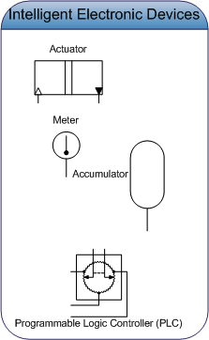
IED Basics
Intelligent Electronic Device
May be data acquisition device only May be responsible for control
Possible inputs: configuration, setting, and command data
Possible outputs: values, conditions, status, and results
May be PLCs programmed with ladder logic
●
●
●
●
●
●

Slide 25
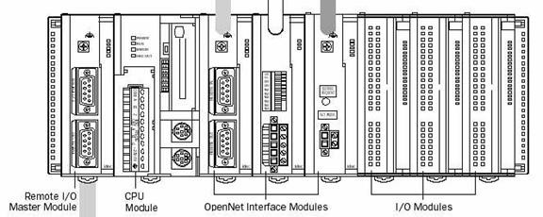
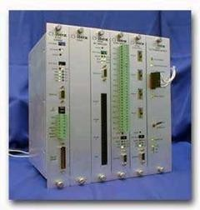
Sample IEDs/PLCs
Programmable Logic Controller (PLC)
Intelligent Electronic
Device
(IED)

Slide 26
Parameters
●
IEDs and RTUs can control and monitor a variety of physical processes and other information:
Accumulate measurements like kilowatt hour consumption
Monitor voltage and current
Monitor temperatures (useful for automatically controlling tunnel fires)
Switch electrical breakers on and off
Transfer configuration files to/from SCADA master

Slide 27
DNP3 Protocol Standard
●
The DNP3 protocol standard defines several aspects of SCADA Master-RTU/IED communications:
Frame and message formats
Physical layer requirements
1200 bps+
Busy link indicator for collision avoidance
–
Data-link layer behavior
frame segmentation
Transmission retry algorithm
–
Application layer
file transfer
time synchronization start/stop service
●
●

Slide 28
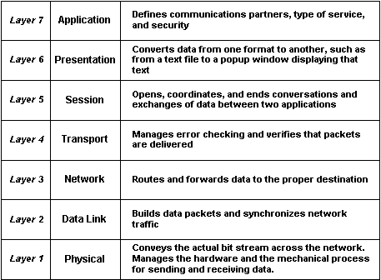
Protocol Basics
●
Built on OSI layers 1,2,7
Application Presentation Session Transport Network Data Link Physical
●
●
●
●
●
●
●
IEC “Enhanced Performance Architecture”

Slide 29
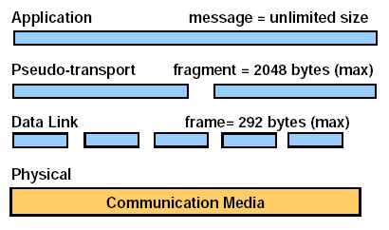
Basic Message Breakdown

Slide 30
Protocol Requirements
●
Components operate in harsh environments Protocol designed for reliability
No confidentiality or integrity checks explicitly included
●
●

Slide 31
Req.: “Data Security”
●
Correct data transmission required in presence of:
EMI: Electromagnetic interference
Differences in earth potential
Aging components
Other sources of noise and disturbance along transmission path

Slide 32
Req.: Data Security (cont.)
Protection explicitly afforded against:
Undetected bit errors
Undetected frame errors caused by synchronization errors
Undetected loss of information
Gain of unintended information
Simulation of valid message by noise
●

Slide 33
Profibus
Profibus (Process Fieldbus) is an open fieldbus serial network standard
Use in time-critical control and data acquisition applications.
It falls under the European international fieldbus standard, EN 50 170
Defines the functional, electrical, and mechanical characteristics of a serial fieldbus.
Profibus is similar to the Foundation fieldbus, but provides transmission rates of 31.25 Kbps, 1Mbps, and 2.5 Mbps in the physical layer.

Slide 34
Profibus
Profibus is an open standard, it can accommodate devices from different manufacturers.
Profibus resides at the application, data link, and physical layers of the OSI model.
It provides determinism for real-time control applications
Supports multimaster and master-slave communication networks.

Slide 35
Profibus Process Automation (PA):
Connects data acquisition and control devices on a common serial bus
Supports reliable, intrinsically safe implementations.
It also provides power to field devices through the bus.
Profibus PA uses the basic functions and extensions available in Profibus DP.

Slide 36
Profibus Factory Automation (Decentralized Peripherals—DP)
Provides high-speed communication between control systems and decentralized control devices.
It uses different physical layer standards than those employed by Profibus PA.
Optional and upward compatible extensions have been added to Profibus DP.
The extended version is denoted as Profibus-DPV1 and includes diagnostics, alarm messaging, and parameterization.

Slide 37
Profibus Fieldbus Message Specification (FMS)
Developed to support a large number of applications and higher-level network interconnections among applications at average transmission rates.
It offers a large selection of functions and is, generally, more complicated to implement than Profibus PA or Profibus DP.

Slide 38
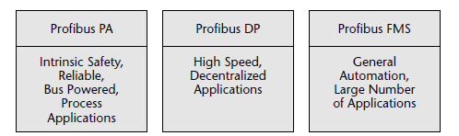
Profibus versions and their primary characteristics

Slide 39
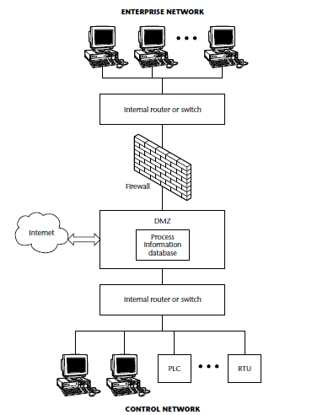
Single firewall DMZ for SCADA

Slide 40
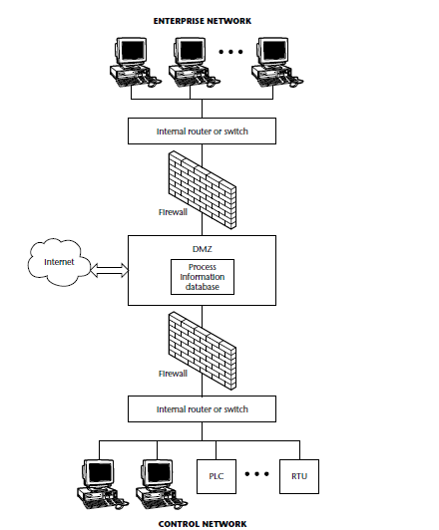
Dual firewall DMZ for SCADA

